Slide 1
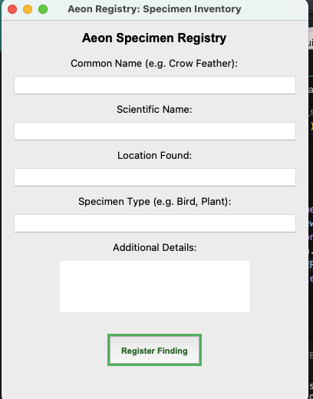
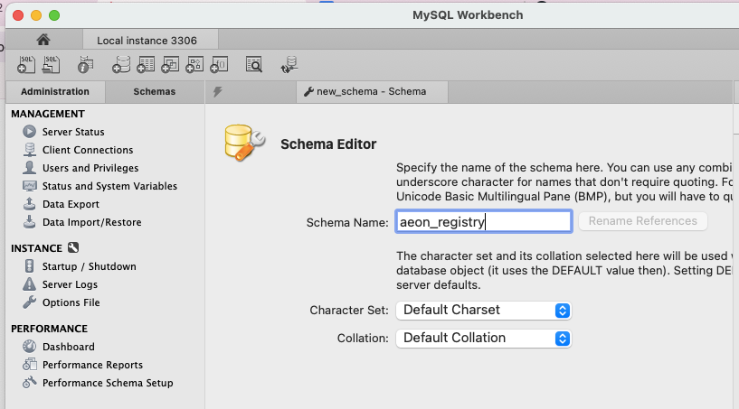
Aeon Registry
Coding Project By Lindsey Peoples
My Idea involves creating a documentation software for collectors, researchers, hobbyists, scientists, ect. This would allow users to have the ability to create a categorized digital entry for specimens or items found in nature. Items could be documented and saved under specific fields like taxonomy, location, scientific name, and specimen type.
A) Example of what the entry software looks like for entry. The coding is created and merged in VS Studio with MySQL Workbench.
B) Shows database in SQL that saves the documentations inputted on the produced Inventory Screen.

